Slide 1
05 | Classification
Cynthia Rudin | MIT Sloan School of Management

Slide 2
Classification
Recap of classification
Loss functions for classification
  Logistic regression
  SVM
  AdaBoost
Decision trees
Multiclass classification
Imbalanced learning
ROC curves and the AUC

Slide 3
Recap of classification
Cynthia Rudin | MIT Sloan School of Management

Slide 4
Classification
Each observation is represented by a set of numbers (features).
Manhole is represented as: [ 5 3 120 12 1 0 ….. ] -1
[ 0 0 89 5 1 1 ….. ] 1
[ 1 0 20 0 0 1 ….. ] -1
: :
Features, called X
Labels, called Y
Notes:
*read* and each observation is labeled.

Slide 5
Classification
Each observation is represented by a set of numbers (features).
Manhole is represented as: [ 5 3 120 12 1 0 ….. ]
Inspected?
Vented cover?
Number of events last year
Number of electrical cables
Number of serious events last year
Number of pre-1930 electrical cables
Notes:
In the running example, each manhole is represented as a vector of numbers where the features are …

Slide 6
Classification
Each observation is represented by a set of numbers (features).
Manhole is represented as: [ 5 3 120 12 1 0 ….. ]
Inspected?
Vented cover?
Number of events last year
Number of electrical cables
Number of serious events last year
Number of pre-1930 electrical cables
Feature data is from 2014 and before
(Label is 1, it exploded in 2013)
Notes:
The feature data is computed from year 2014 and before

Slide 7
Classification
Each observation is represented by a set of numbers (features).
Manhole is represented as: [ 5 3 120 12 1 0 ….. ]
Inspected?
Vented cover?
Number of events last year
Number of electrical cables
Number of serious events last year
Number of pre-1930 electrical cables
Feature data is from 2014 and before
(Label is 1 if it exploded in 2015)
Notes:
The label data is what happened in 2015 *read*.
Then when we get feature data from 2015, we use our model to predict what will happen in 2016.

Slide 8
Classification
Formally, given training set (x_{i,}y_{i}) for i=1…n, we want to create a classification model f that can predict label y for a new x.

Slide 9
Classification
Formally, given training set (x_{i,}y_{i}) for i=1…n, we want to create a classification model f that can predict label y for a new x.
Manhole is represented as: [ 1925 15]
Year oldest cable installed
Number of events last year
Notes:
Let’s again say that each manhole is represented by 2 features… which allows us to plot these points in the plane.

Slide 10
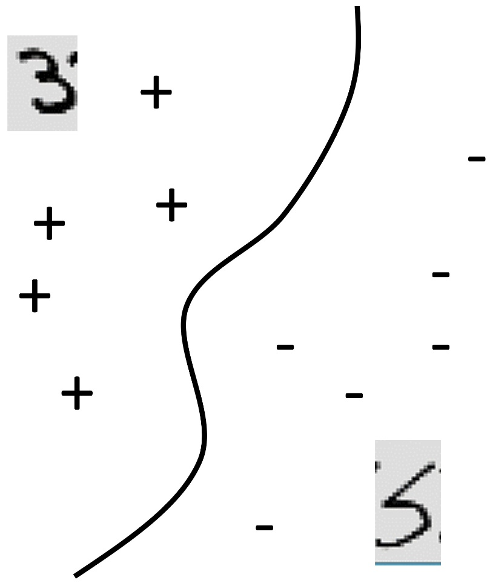
Classification
Formally, given training set (x_{i,}y_{i}) for i=1…n, we want to create a classification model f that can predict label y for a new x.
20
Manhole is represented as: [ 1925 15]
Events Last Year
Year oldest cable installed
Number of events last year
0
1925
Oldest cable
2015

Slide 11
Classification
Formally, given training set (x_{i,}y_{i}) for i=1…n, we want to create a classification model f that can predict label y for a new x.
20
f(x)>0
f(x)=0
f(x)<0
Manhole is represented as: [ 1925 15]
Events Last Year
Year oldest cable installed
Number of events last year
0
1925
Oldest cable
2015
Notes:
We want to create a function that is positive for manholes that did or will explode, and negative for manholes that didn’t or won’t explode. And the decision boundary is where f(x)=0.

Slide 12
Classification
Formally, given training set (x_{i,}y_{i}) for i=1…n, we want to create a classification model f that can predict label y for a new x.
20
f(x)>0
f(x)=0
f(x)<0
f(x) = function(Events Last Year, Oldest Cable)
Events Last Year
0
1925
Oldest cable
2015
Notes:
That function is going to eat the two features … and produce a number. We take the sign of the number, and that’s the predicted class. Give me a new example I’ve never seen before, you give me it’s feature vector, I plug those values into f, then I get a number. If it’s a positive number I predict an explosion, if it’s a negative number I predict no explosion.

Slide 13
Classification
Formally, given training set (x_{i,}y_{i}) for i=1…n, we want to create a classification model f that can predict label y for a new x.
The machine learning algorithm will create the function f for you. It might be very complicated, but the way to use is is not complicated:
The predicted value of y for a new x is the sign of f(x).
Notes:
So just to repeat

Slide 14
Loss functions for classification
  Logistic regression
  SVM
  AdaBoost
Cynthia Rudin | MIT Sloan School of Management

Slide 15
Loss Functions for Classification
How do we measure classification error?
Fraction of times sign(f(x_{i})) is not y_{i}
Classification algorithms try to find f that minimizes classification error. Unfortunately they can’t usually minimize this directly, because it is usually computationally hard.
Notes:
*read* So we’ve got to do something about that.

Slide 16
Loss Functions for Classification
Fraction of times sign(f(x_{i})) is not y_{i}
Notes:
Luckily there’s a trick that really makes all the difference here. The first step is to realize that these two things are equal to each other. Why are those equal?
Think about it. There are only a few possibilities. If y is positive and f is positive, then we don’t make a mistake, and the top is 0. yf is positive, not negative, so the bottom is 0.
If y and f are both negative, then we don’t make a mistake, the top is 0 and and yf is positive again.
If y is positive and f is negative, then we make a mistake, we lose a point up here, and we also lose a point down here because y times f is negative.
Same thing if y is negative and f is positive.
So these logical expressions are equal to each other.

Slide 17
Loss Functions for Classification
Fraction of times sign(f(x_{i})) is not y_{i}
Notes:
So now I’m plotting possible values for yf on the horizontal axis. This is function that’s logical, so its either 0 or 1. Here the loss is 1 only when y*f is negative. You’ll see this plot again soon.

Slide 18
Loss Functions for Classification
Fraction of times sign(f(x_{i})) is not y_{i}
Notes:
We’re going to do this trick that’s extremely common in ML which is to create an upper bound for the logical expression. We’re going to use a function that is easier to work with computationally. That function is called a loss function.

Slide 19
Loss Functions for Classification
Fraction of times sign(f(x_{i})) is not y_{i}
Notes:
The loss function is an upper bound for the logical function. What’s so nice is that it’s smooth, which means it is easier to work with. You can choose many many different loss functions, and I’m going to tell you about a few.

Slide 20
Loss Functions for Classification
Notes:
Start with this picture,

Slide 21
Loss Functions for Classification
Notes:
Here is our classification objective that we’re going to minimize. It’s the loss function… and then we added some regulazation in there to get some occham’s razor going so we don’t overfit. This thing is called the 0-1 empirical risk, and this one is the risk using the loss function l. And that’s the trick.

Slide 22
Loss Functions for Classification
Different machine learning algorithms use different loss functions
Notes:
*Read* and I’m going to show you some of them.

Slide 23
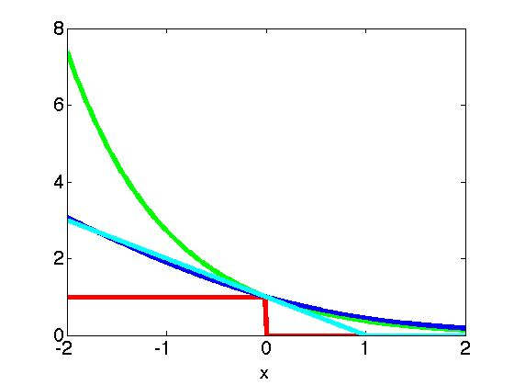
Loss Functions for Classification
Notes:
Again the horizontal axis is y times f(x). The red one is 1 if y agrees with the sign of f, and then other curves are for different algorithms.

Slide 24
Loss Functions for Classification
Incorrectly classified
Correctly classified
Notes:
Just keep in mind that On the right are points that on the correct side of the decision so they don’t suffer much penalty and on the left are points that are incorrectly classified so they suffer more penalty.

Slide 25
Loss Functions for Classification
Notes:
*click*

Slide 26
Loss Functions for Classification
Notes:
We’ll start with the logical function that just measures whether or not there’s a classification error, when y times f <0.

Slide 27
Loss Functions for Classification
(AdaBoost)

Slide 28
Loss Functions for Classification
(AdaBoost)
(SVM)

Slide 29
Loss Functions for Classification
(AdaBoost)
(Logistic Regression)
(SVM)
Notes:
Each of these losses corresponds to a different ML algorithm.

Slide 30
Loss Functions for Classification
Different machine learning algorithms use different loss functions and different regularization terms.
Notes:
Ok so we talked about the loss function, but what about regularization.
Logistic regression and boosting don’t use regularization. SVM uses something like the sum of squares of the coefficients similar to ridge regression. Let me talk a little more about these algorithms

Slide 31
Logistic Regression
Logistic regression often uses gradient decent
  Very fast
  Often competes with the best ML algorithms
Notes:
Is a very old algorithm. Dates back at least 50 years. But it really works! <Talk about claudia and online advertising.>

Slide 32
SVM
SVM uses mathematical programming (usually a custom QP solver)
  Standard solvers are slow
  SVM has advantage of kernels – nonlinear transformations of variables
    Linear kernels = linear model
    Polynomial kernels = polynomial model
    Gaussian kernels (or “radial basis function – RBF” kernels = sum of bumps centered at the training observations
      You can choose the width of the bumps (“bandwidth” parameter)
Notes:
*that’s worth expanding on, so let me show you that graphically.*

Slide 33
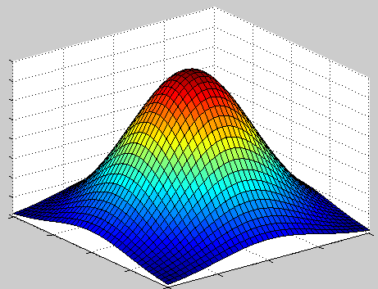
SVM
Notes:
This is a weighted sum of bumps called K, centered at xi. This is a bump, think of it as being centered at xi.

Slide 34
SVM
Notes:
There are lot of training observations, so we have to add a lot of bumps together.

Slide 35
SVM
Notes:
Some of the bumps could be right side up and some of them could be upside down, depending on what the alphas are.

Slide 36
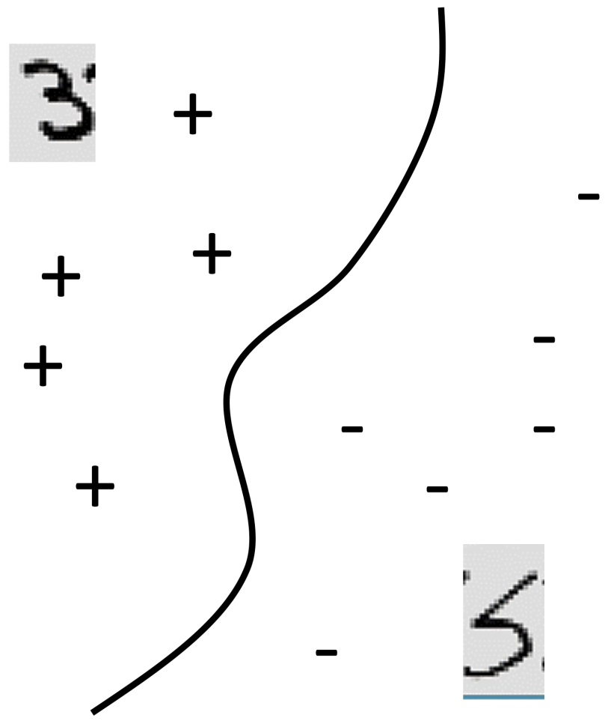
SVM
X(2,.)
0
x(1,.)

Slide 37
Boosting
Boosting uses coordinate descent
  Moderate speed
  “Meta-algorithm” – runs on top of another algorithm.
  At every step it might generate a complicated model to add to f

Slide 38
Classification
You do not need to solve the optimization problem yourself.
Input: (matrix X, vector Y)
Select which algorithm and which settings
Hit go.

Slide 39
Decision Trees
Cynthia Rudin | MIT Sloan School of Management

Slide 40
Decision Trees
Logical models
age≤30
age>30
#classes>8
#classes≤8
Bschool
No Bschool
laundry
No laundry
Male
Female
Predict y=-1
Predict y=-1
Predict y=-1
Predict y=1
Predict y=1
Predict y=1
Predict y=1
Predict y=-1

Slide 41
Decision Trees
Logical models
X(1,.)>3
X(1,.)≤3
X(7,.)≤0
X(52,.)>8
X(52,.)≤8
X(7,.)>0
X(15,.)<5
X(7,.)>12
X(2,.)<5
X(2,.)≥5
X(1,.)≥-7
X(7,.)≤12
X(1,.)<-7
X(15,.)≥5
Predict y=-1
Predict y=-1
Predict y=-1
Predict y=1
Predict y=1
Predict y=1
Predict y=1
Predict y=-1

Slide 42
Decision Trees
The main decision tree algorithms are very old: Breimans’ CART – 1982, and Quinlan’s C4.5 – 1995.
The tree is built in from the top down
Supposed to give a balance between accuracy and interpretability. CART tends to give very interpretable results that are not that accurate.
Boosted decision trees, however, give excellent performance in general (see for instance Caruana and Niculescu-Mizil, 2005)

Slide 43
Multi-class classification
Cynthia Rudin | MIT Sloan School of Management

Slide 44
Multi-class classification
If you can solve binary classification, you can solve multiclass classification.
There are specialized algorithms, but the simplest is to do “1 vs all”.
  Create a classifier to predict each class separately
  Choose the classifier with the strongest “confidence” in the class
X (chair, tomato, bird, pepper,…)
Notes:
*read*
Here you want a function that given a new x, predicts which of possibly many classes x best fits into. So here, if X is an image, we want to know if X is an image of a chair, a tomato, and bird, a green pepper, and so on. Now there are specialized algorithms for multiclass classification, but the simplest things to do is called 1 vs all. To do 1 vs all, you just take your favorite classification algorithm, and you create a binary classification problem for each class. So we’d create a separate classifier for chair/not chair, … and we’ll use *those* classifiers to get us the solution to the multiclass problem. Since our classifiers have a value of f(x), we can use it as a sort of confidence measure for the prediction. So if you have an image of a chair, the “chair” classifier would say “I’m absolutely certain that this image is a chair by giving a large positive value of f(x)”. Chances are that the chair classifier would be the most certain about classifying the image, which would tell us to trust that classifier. There are other ways to do multiclass classification than 1 vs all, but I wanted to explain to you how being able to solve a regular classification problem can directly get you the solution to a multiclass problem.

Slide 45
Imbalanced data
Cynthia Rudin | MIT Sloan School of Management

Slide 46
Imbalanced Data
Many classification algorithms produce garbage when the data are highly imbalanced (e.g, decision trees).
Do not use classification accuracy (if 99% negative examples, a model that always predicts negative is 99% accurate).
Instead use true positive rate and false positive rate.
One trick is to oversample the minority class so that the data looks more balanced than it really is.
Another trick is to weight mistakes on the minority class more highly.

Slide 47
ROC Curves
Cynthia Rudin | MIT Sloan School of Management

Slide 48
ROC Curves
Started during WWII for analyzing radar signals.
For a particular False Positive Rate (FPR), what is the True Positive Rate (TPR)?
FPR = number of negatives that were classified by the ML algorithm as positives / total number of negatives
TPR = number of positives that were classified by the ML algorithm as positives / total number of positives

Slide 49
ROC Curves
For a particular False Positive Rate (FPR), what is the True Positive Rate (TPR)?
1
TPR
0
FPR
0
1

Slide 50
ROC Curves
For a particular False Positive Rate (FPR), what is the True Positive Rate (TPR)?
1
TPR
0
FPR
0
1

Slide 51
ROC Curves
For a particular False Positive Rate (FPR), what is the True Positive Rate (TPR)?
1
TPR
0
FPR
0
1

Slide 52
ROC Curves
For a particular False Positive Rate (FPR), what is the True Positive Rate (TPR)?
1
TPR
0
FPR
0
1

Slide 53
ROC Curves
For a particular False Positive Rate (FPR), what is the True Positive Rate (TPR)?
1
TPR
0
FPR
0
1

Slide 54
ROC Curves
For a particular False Positive Rate (FPR), what is the True Positive Rate (TPR)?
1
TPR
AUC
0
FPR
0
1

Slide 55
ROC Curves
For a particular False Positive Rate (FPR), what is the True Positive Rate (TPR)?
1
Be better than this line
TPR
0
FPR
0
1
Notes:
If you’re not better than that line, you might want to turn your classifier upside down so it predicts the opposite of what it’s currently doing. Because it’s worse than random guessing, which means it could be better if you flipped it. Hopefully you’ll get a curve like I showed you on the previous slide. Most of the time you don’t get perfect. Most prediction problems are not that easy.

Slide 56
Coming Up
Clustering
Notes:
ML is most known for its ability to handle classification.

